Slide 1
Event Sourcing
CEN 3031 – Introduction to Software Engineering

Slide 2
N-Tier Architecture
User Interface
Application Tier (ORM)
Data Tier

Slide 3
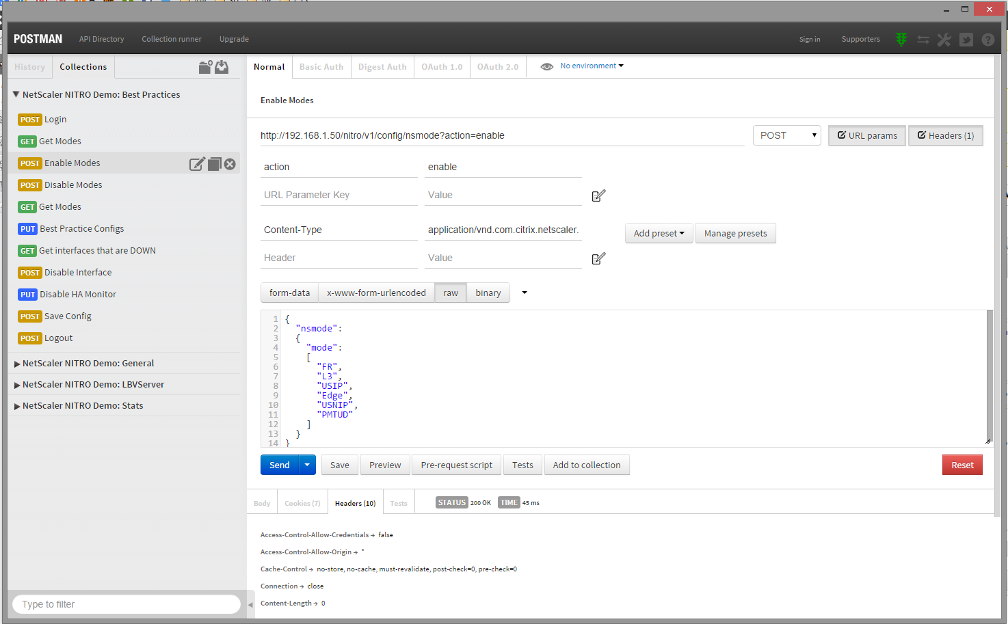
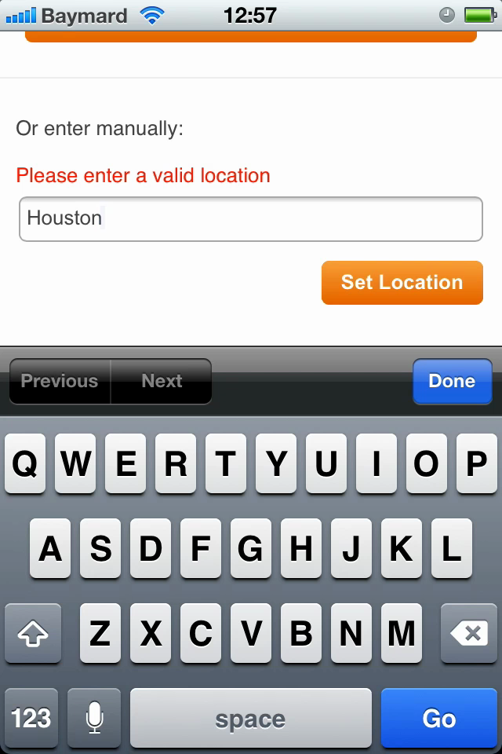
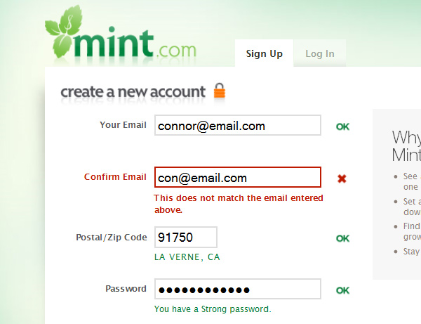
User Interface
Notes:
User inputs/requests the data
Displays messaging, alerts, errors
Could be multiple
HTML, Mobile, Native, APIs, SDKs
**** Should not be relied upon

Slide 4
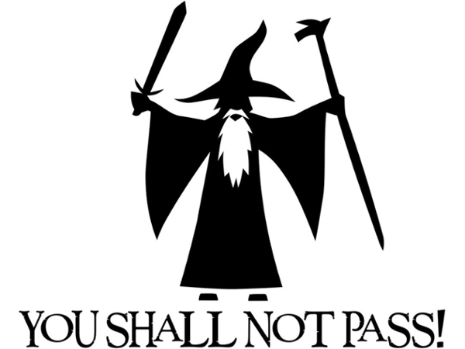
Application Tier
Notes:
Validates data
Authentication, Authorization, Validation, Business Logic

Slide 5
Application Tier
UI
Logic
Data
Notes:
Takes data on screen puts into data storage format
Takes data from storage presents to UI

Slide 6
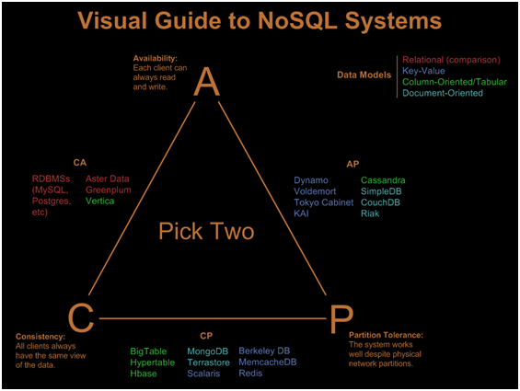
Data Tier
Notes:
Persists data to disk
Has considerations for CAP theorem
https://static.googleusercontent.com/media/research.google.com/en//pubs/archive/45855.pdf

Slide 7
Its simple
This allows for easy conceptualization
Data is usually normalized, makes updates easy
Data follows a clear concise path from user to database and back
ORM typically make this even easier
One can usually generate the other

Slide 8
Well… Bank Accounts
Update: $150
Update:
$75
Update: $100
???

Slide 9
How would you do it?
Starting balance: $100
Lunch: -$25
Deposit: +$50
Balance the checkbook: $125

Slide 10
Language
N-Tier
Event Sourcing
Insert Account
Update Account
Delete Account
Account Created
Account Deposited
Account Withdrawn
Account Removed

Slide 11
UI
Please Create -
Valid Event
Created
View Model
Created
Account
Marketing
Welcome
Mobile
Msg Bus
Created
Event Store
Model Store
???

Slide 12
Code Example

Slide 13
Rainbows and Unicorns
Pros
Cons
Easily distribute data
High Read/Write throughput
Transaction log Replay
Modularity
Complex
Data is not normalized / duplicated multiple times (potentially)
Lost / Out of order messages

Slide 14
Who is using this?
Financial Systems
Banks
Stock Exchanges
Gambling
Systems where temporal data / history is important

Slide 15
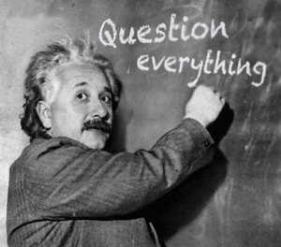
Questions

Slide 16
Joseph Cutrono
Manager Innovation Strategy
https://github.com/jcutrono/go-eventsource
http://www.ultimatesoftware.com/internships
internships@utimatesoftware.com

